Slide 1
The UNIVERSITY of OKLAHOMA
American Indian Science & Engineering Society

Slide 2
Corporate Sponsorship Proposal
A key proponent to fundraising and marketing

Slide 4
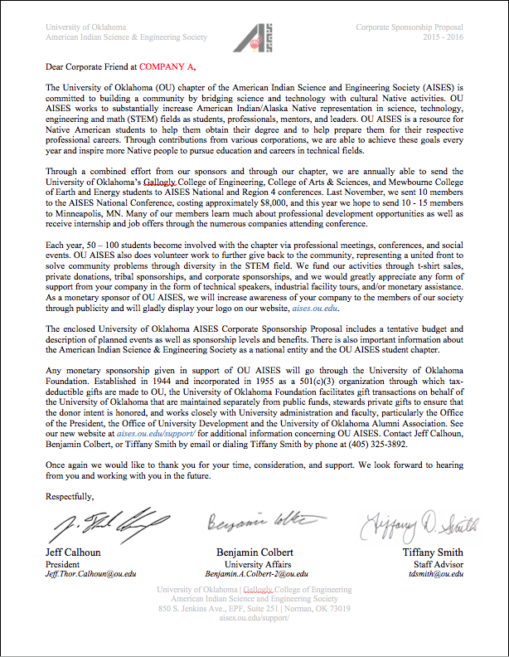

Slide 5
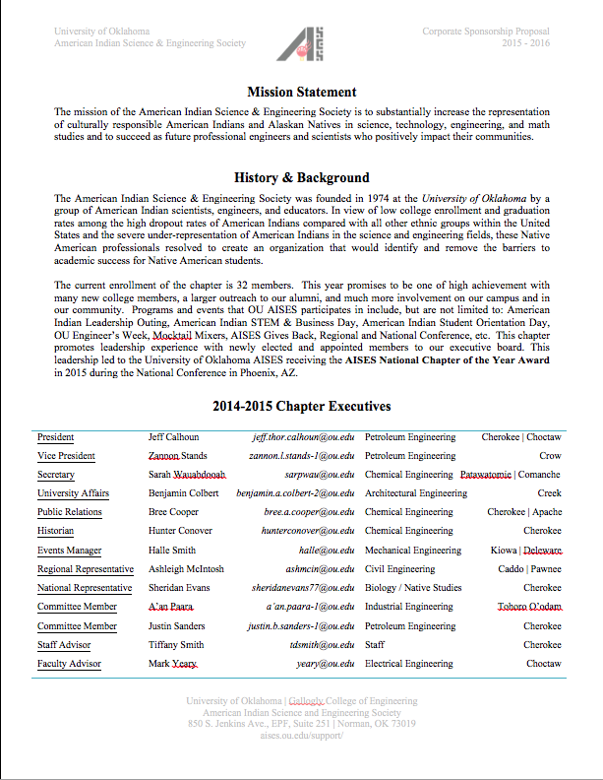

Slide 6
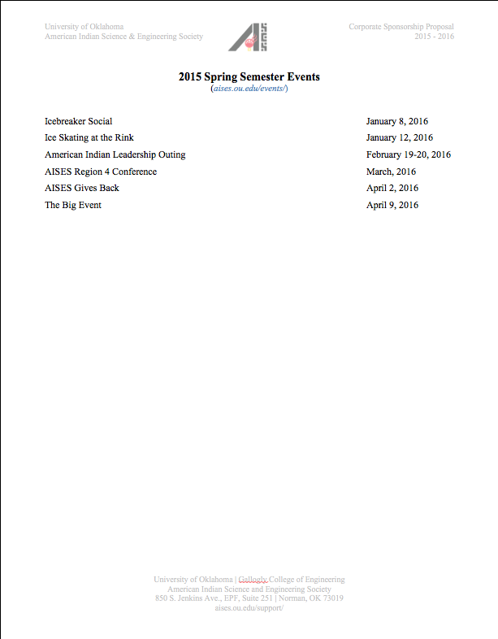

Slide 7
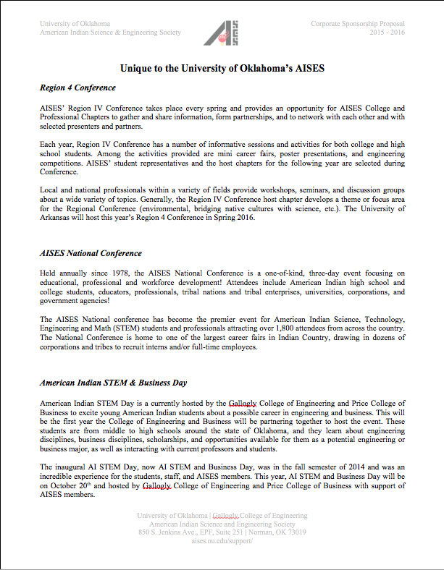

Slide 8
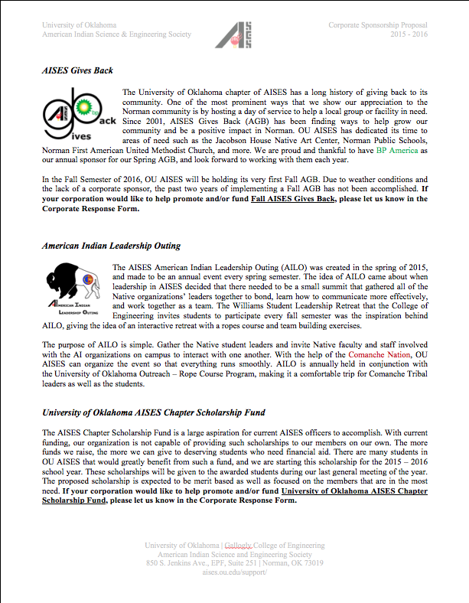

Slide 9
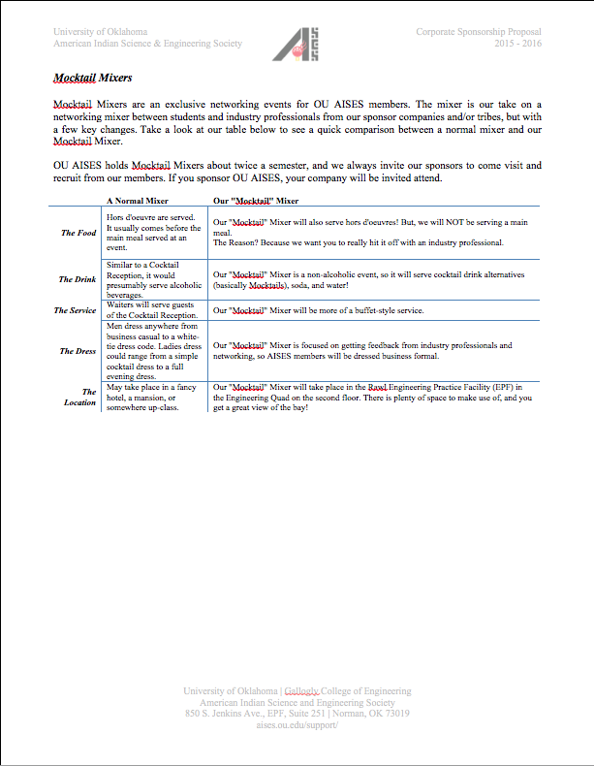

Slide 10
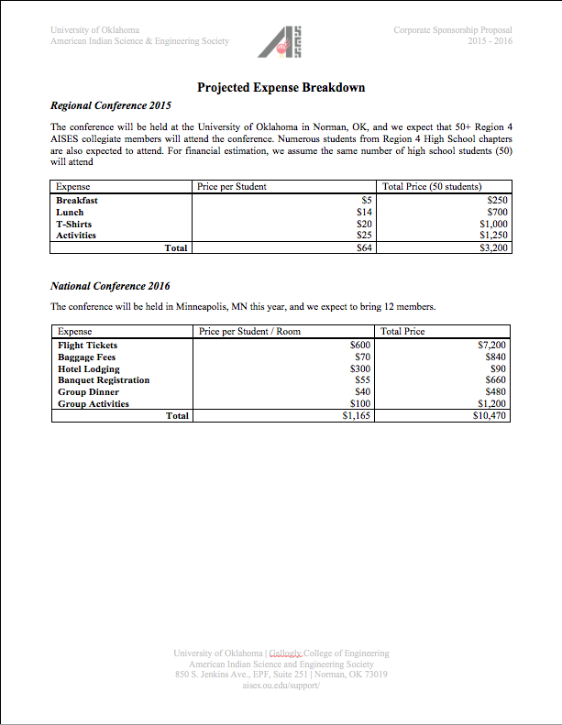

Slide 11
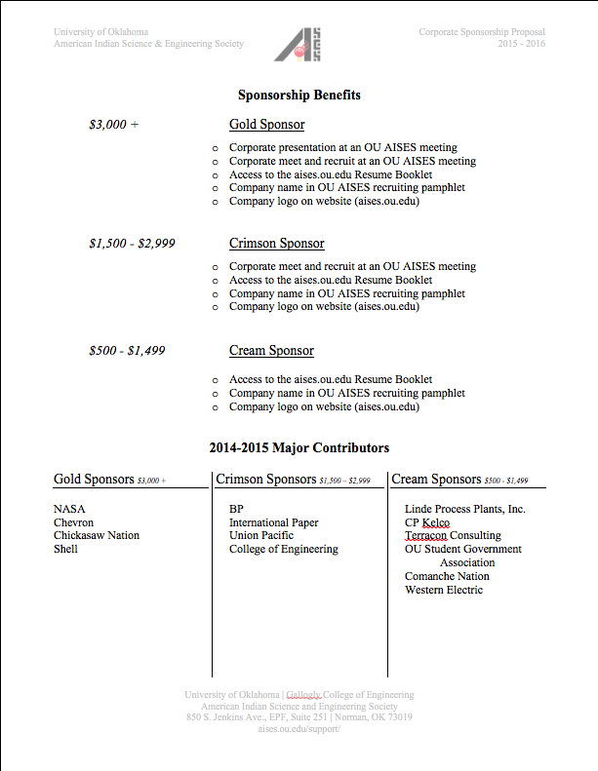

Slide 12
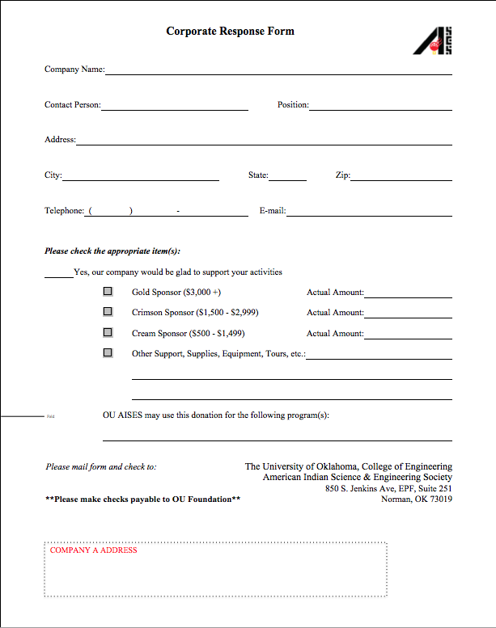

Slide 13
aises.ou.edu
Another avenue of raising funds for you organization

Slide 14
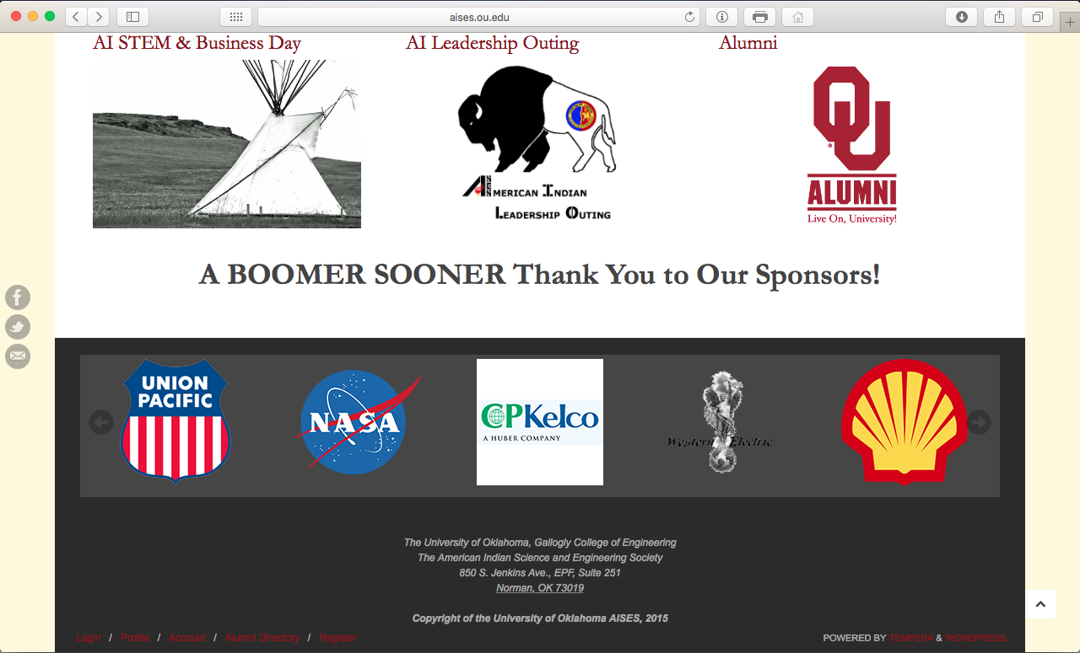
We currently have 14 sponsors, and are adding new sponsors each semester.

Slide 15
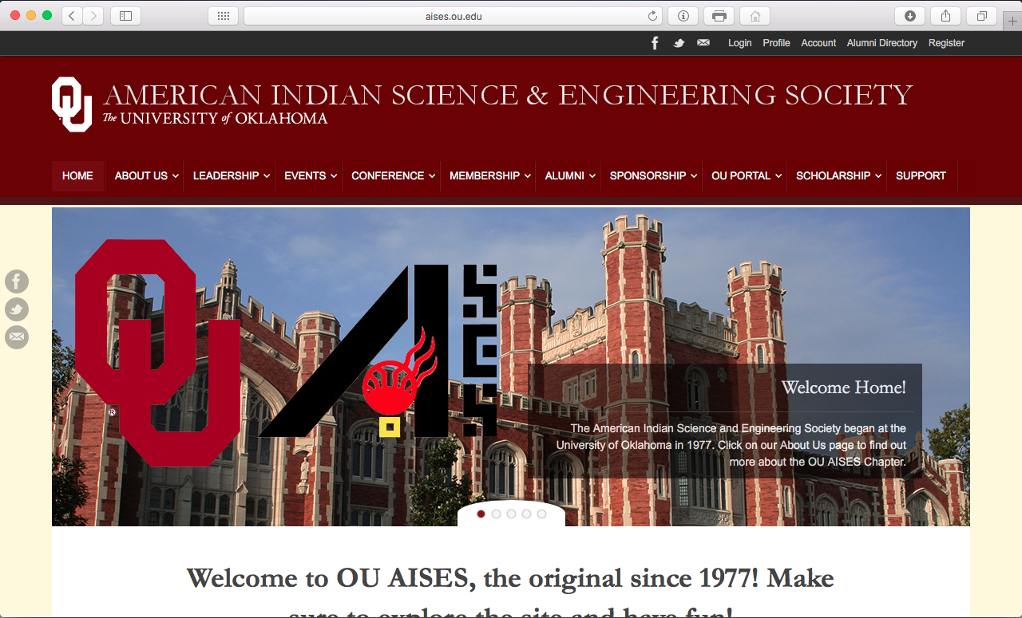
See us @ aises.ou.edu
Follow us on twitter @OUAISES
Like us on Facebook @OUAISES
Contact us @ aises@ou.edu

Slide 16
